Slide 1
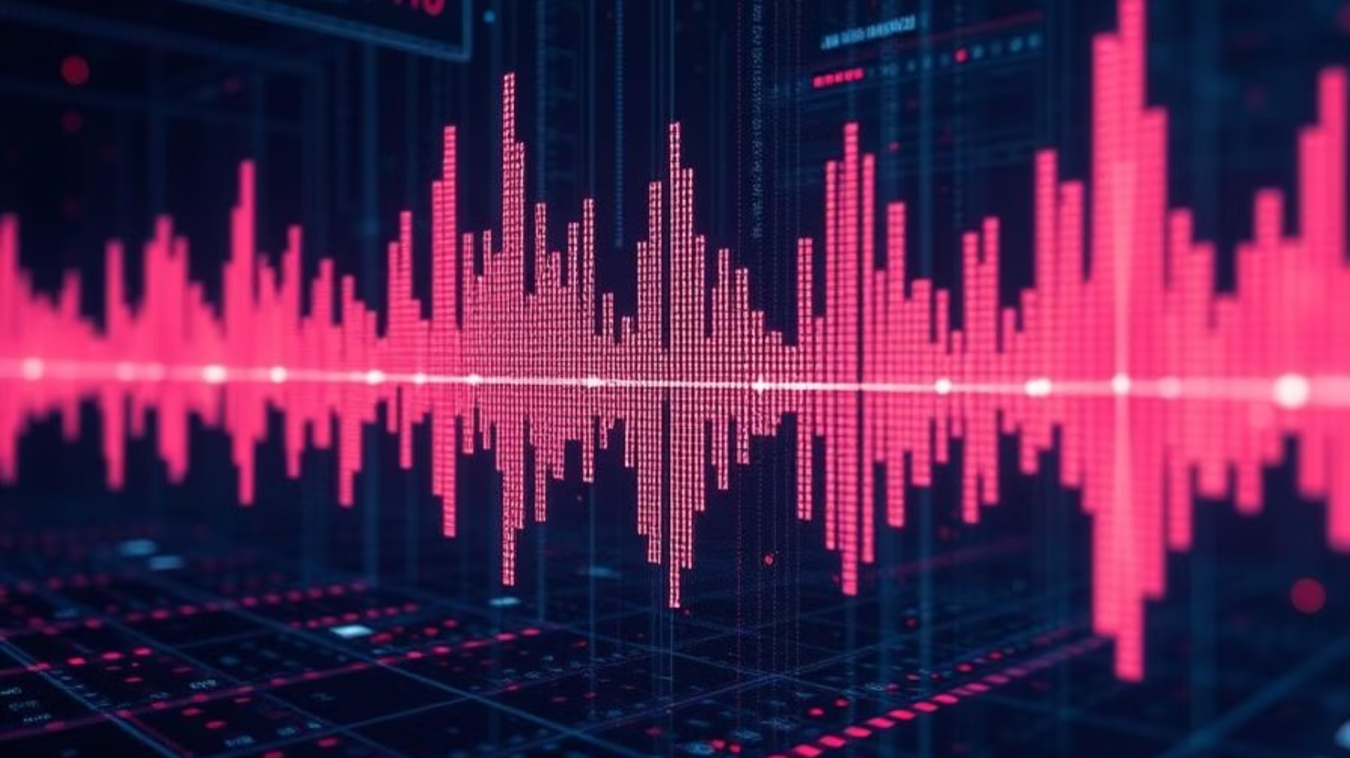
MINI PROJECT - II
VoiceGuard: Detecting AI-Generated Audio
Project Guide : Dr. Ramu Kuchipudi,
Presented By: N.Anvesh (160122737050) J.SaiTeja (160122737044) R.Tomson (160122737056)

Slide 2
Problem Statement
AI-driven speech synthesis has evolved rapidly, making traditional detection methods ineffective. Deepfake audio can convincingly replicate a person's voice, posing risks to security, privacy, and credibility. Existing models struggle to generalize across various attack types. This project proposes a CNN-LSTM solution, trained on diverse datasets, to address the need for an accurate, real-time detection system that can effectively classify audio as real or AI-generated.

Slide 3

Abstract
Deepfake audio, generated through AI-driven speech synthesis, has become a growing concern due to its potential misuse in fraud, misinformation, and identity theft. This research focuses on improving deepfake audio detection using a hybrid CNN-LSTM model combined with advanced feature extraction techniques. The Mel-Frequency Cepstral Coefficients (MFCCs) are used as primary features, while additional spectral and statistical features enhance model performance. The ASVspoof-2019 dataset is employed to train and evaluate various deep learning architectures.

Slide 4
Exisiting Solutions:
DFAD (DeepFake Audio Detector): A lightweight deep learning model optimized for mobile and edge devices, using log-mel spectrogram features to identify synthetic patterns in audio.
LCNN-based Detection Models: Light Convolutional Neural Networks have been used for their efficiency and ability to extract spatial features from spectrograms of audio signals.
WaveFake and FakeBuster: These tools utilize deep neural networks for real-time detection of synthetic audio, focusing on deployment in communication systems and content moderation platforms

Slide 5
Introduction
Deepfake audio can mimic real voices with high accuracy, posing serious threats in areas like cybersecurity, fraud, and law enforcement. This project, VoiceGuard, aims to detect such synthetic audio using a smart deep learning model.We use a CNN-LSTM architecture to understand both sound patterns and time-based changes in audio. Key audio features are extracted, and the model is trained on the ASVspoof 2019dataset.VoiceGuard helps ensure that voice communication stays secure and trustworthy in the age of AI.

Slide 6
Literature Survey
Early Detection Methods: Used traditional algorithms like SVM and GMM with hand-crafted features (e.g., MFCCs), but struggled with generalization.
Advancements in Deep Learning: Combining CNNs for spatial analysis with LSTMs for temporal learning significantly improved accuracy.
New Feature Extraction Techniques: CQCCs, spectrograms, and raw audio input further enhanced detection performance.
Innovations: Attention mechanisms, ensemble learning, and transfer learning have
shown promise.
Challenges: Performance drops with new synthesis techniques, background noise, and
limited data remain.

Slide 7
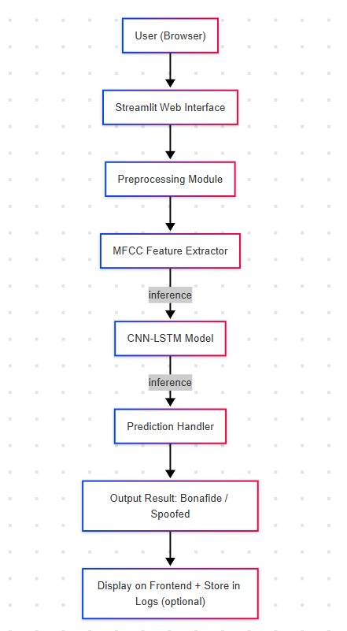
System
Architecture

Slide 8


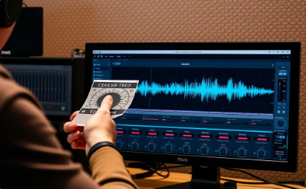

Methodology
Home Page
About Us
Audio Upload & Preprocessing
Deepfake Detection & Results
The application entry point welcoming users and guiding them to explore platform features.
Outline of project objectives addressing deepfake audio threats and the importance of detection.
Upload audio for analysis with preprocessing like normalization and feature extraction.
Hybrid CNN-LSTM model classifies audio as genuine or fake with detailed metrics shown.

Slide 9
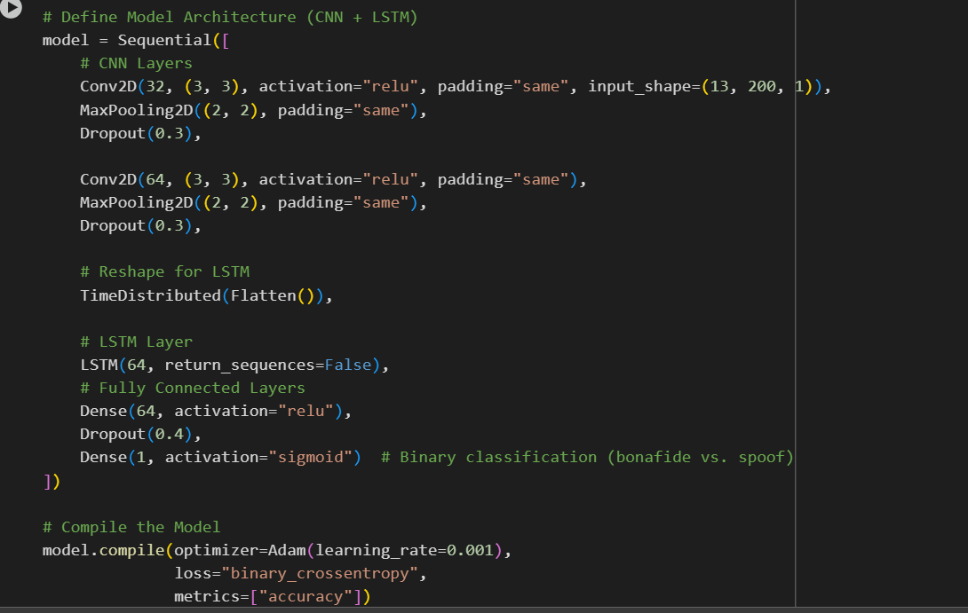
Implementation

Slide 10
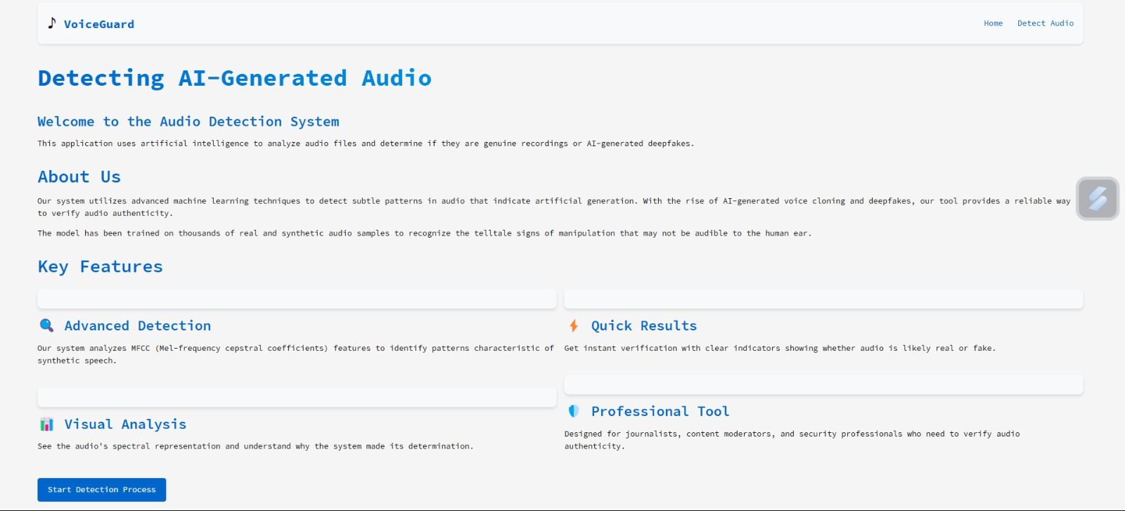
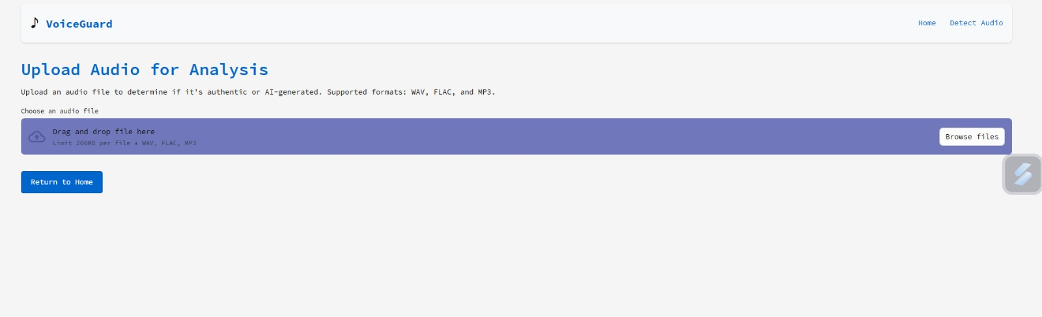
Results: User Interface
Fig 1: Home page layout enhances navigation and introduction.
Fig 2: Diet Recommendation page shows personalized meal suggestions based on data inputs.

Slide 11
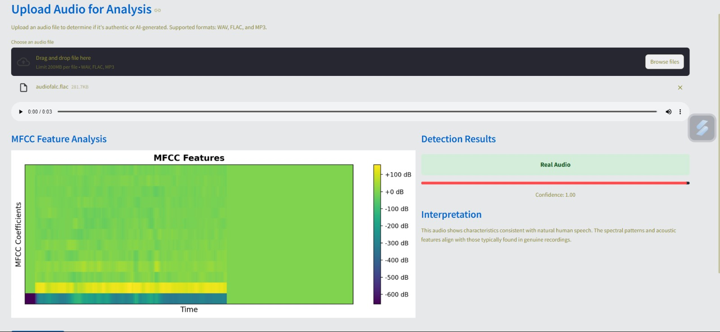
Result of real audio
Fig 3: Accurate BMI and calorie computations guide diet planning.
Fig 4: Recommended recipes include images and nutritional data.

Slide 12
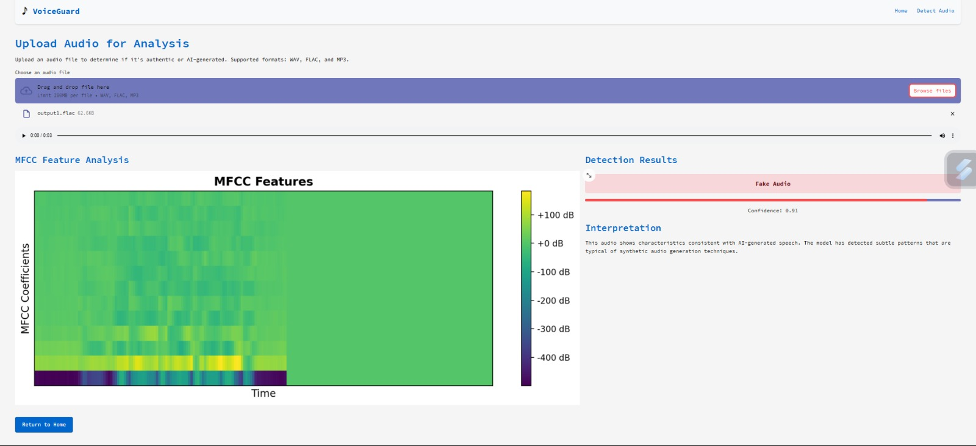
Result of Fake audio
Fig 3: Accurate BMI and calorie computations guide diet planning.
Fig 4: Recommended recipes include images and nutritional data.

Slide 13
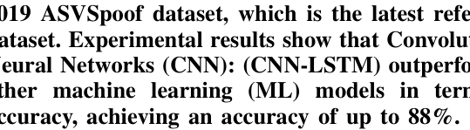
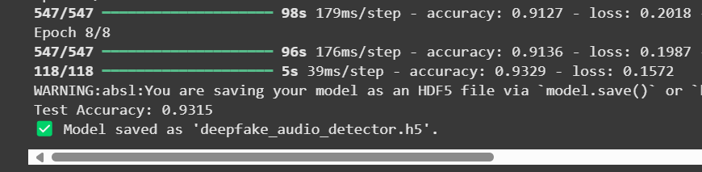
Accuracy Comparision
Fig 3: Accurate BMI and calorie computations guide diet planning.
Fig 4: Recommended recipes include images and nutritional data.

Slide 14
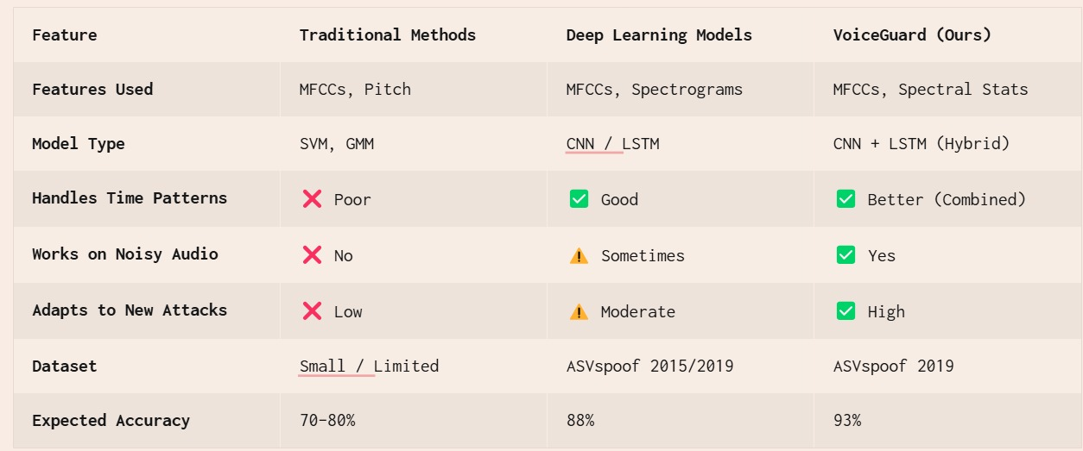
Comparision of existing systems

Slide 15

Conclusion
The rise of deepfake audio presents serious challenges in digital security and trust. This project offers a robust solution using a hybrid CNN-LSTM model enhanced with spectral and statistical features to accurately detect AI-generated audio. By leveraging advanced feature extraction, deep learning techniques, and a structured evaluation approach, the system demonstrates high performance in distinguishing between real and synthetic speech.
Despite current limitations such as generalization to unseen synthesis methods and noise interference, this model marks a significant step forward in combating audio-based misinformation and preserving audio authenticity.

Slide 16

Thank You
We appreciate your attention
and interest in VoiceGuard.

